Slide 1
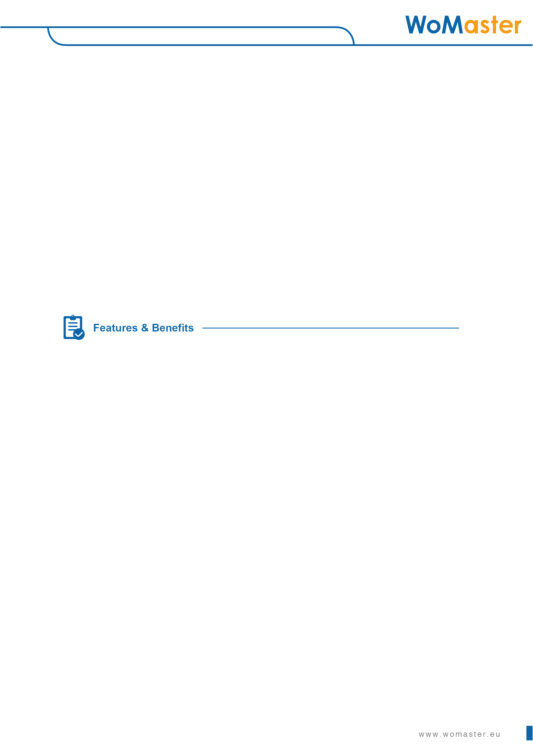
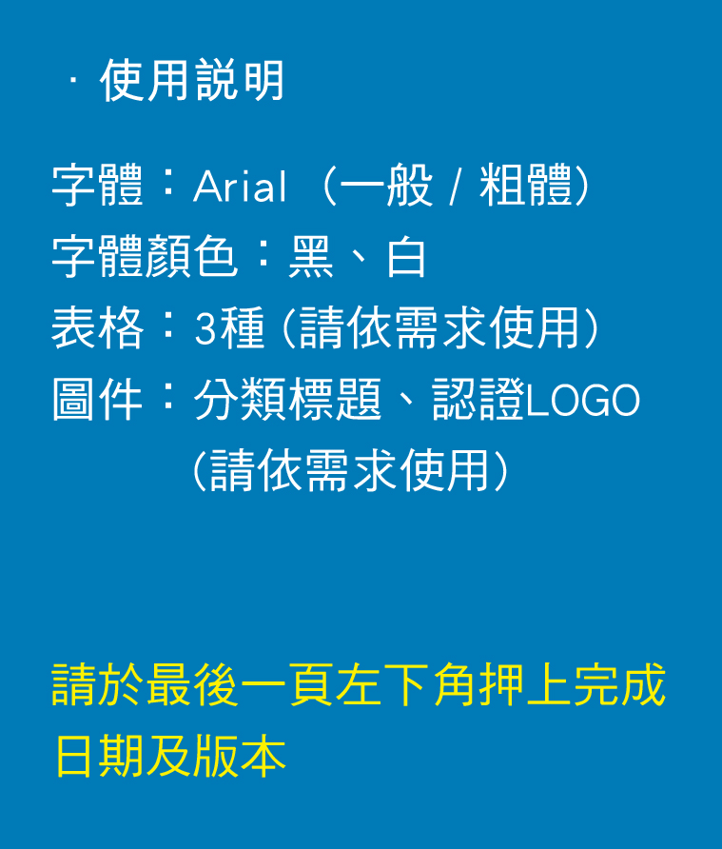
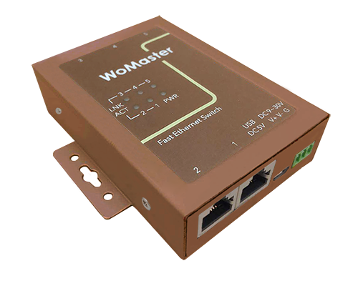


























Industrial Unmanaged Ethernet Switch
Low Power USB Charged, Palm Sized 5 port Switch
DS105 series
Industrial 5-port Unmanaged Ethernet Switch
The low power rugged design 5 port switch DS105 can stand for harsh environment and wide temperature (-40 to 75°C) use. Ultra low power design consumes only 0.8W during full traffic. The compact size can fit in for space limited installation such as vehicle wall-mounting or Din-mount for cabinets. Micro USB DC 5V power input is flexible for installation.
Ethernet Network Switching
・5-port 10/100BaseTX Ethernet with auto Negotiation, auto MDI/MDIX
・Stores and forwards with non-blocking switch fabric
IEEE 802.3az EEE Power Management
・Ultra low power design, less than 1W (0.81W) when full loading
・Energy Efficient Ethernet for low power requirement
・Idle power saving mode for energy efficiency
Broadcast Storm Protection & QoS
・Auto drop excessive incoming broadcast packets for network availability protection
・Port-based QoS port for Ethernet Port 4/5
Versatile Power Input and Mounting
・5~30VDC wide range power input
・Micro USB connector for USB DC 5V power input
・Redundant power design: 5~30V/USB 5V
・Support Wall-mount and Din-mount
Rugged Mechanical Design
・Ultra compact mechanical design
・Wide operating temperature range -40 ~ 75°C
・CE marking
・IEC61000-6-2/IEC61000-6-4 heavy industrial EMC
1.

Slide 2
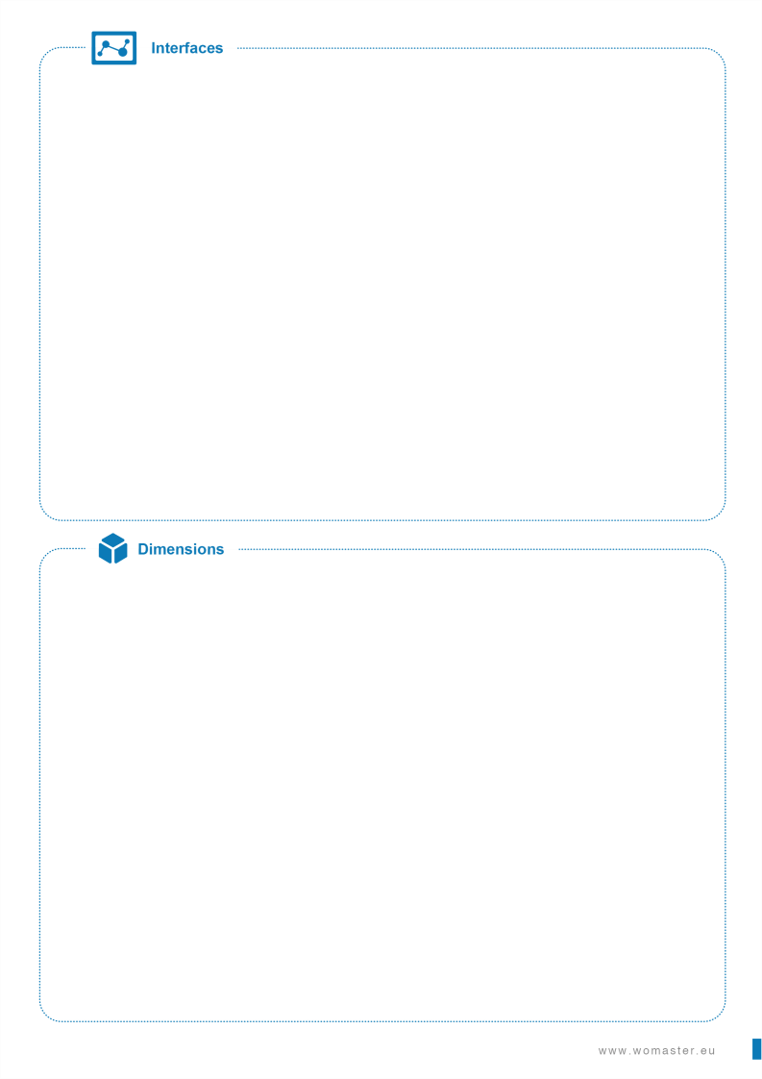
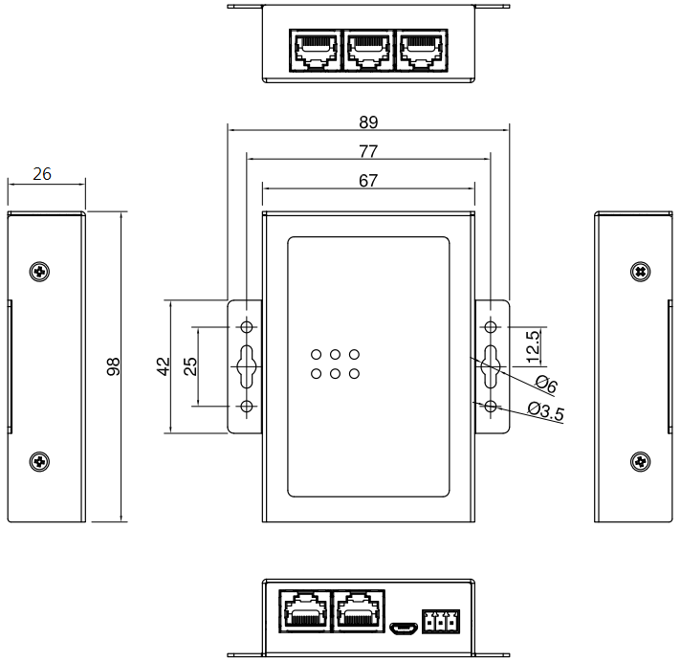
Wall Mount Clip
・Also used for DIN rail mounting
with bracket (Bracket not Included)
System LED
・1 x Power
・5 x Ethernet Port LNK/ACT
Integrated Power Connector
・3-Pin Removable Terminal Connector
2 Pin for Power Input (V+, V-)
1 Pin for Ground
Wall Mount Clip
・Also used for DIN rail mounting
with bracket (Bracket not Included)
USB 5V Power Input
・MicroUSB Connector
Ethernet Network
・5-port 10/100MBase-TX
(3-port on top, 2-port on bottom)
(mm)
2.

Slide 3

Technology
Standard | IEEE 802.3 10Base-T Ethernet
 | IEEE 802.3u 100Base-TX Fast Ethernet
 | IEEE 802.3az Energy Efficient Ethernet
Performance
Switch Technology | Store and Forward Technology with Non-Blocking Switch Fabric
Number of MAC Address | 1K
Packet Buffer Memory | 448K bits
Broadcast Storm Protection | Supported
QoS | Port Based QoS on Ethernet Port 4/5
Transfer performance | 10Base-T: 14,880pps, 100Base-TX: 148,800pps
Interface
Ethernet Port | 5 x 10/100Base-TX RJ45, Auto Negotiation, Auto MDI/MDIX
System LED | 1 x Power: Green On 5 x Ethernet Port: Link (Green On), Activity (Green Blinking)
Power input | MicroUSB for DC 5V or 3-Pin Removable Terminal Connector 2 Pin for Power Input (V+, V-) 1 Pin for Ground
Power Requirement
Input Voltage | 24VDC(5~30 VDC) in Terminal Block or 5 VDC in MicroUSB Redundant power: 5~30V/USB 5V
Reverse Polarity Protect | Yes
Input Current | 0.034A@24V
Power Consumption | Max. 0.81W@24V full traffic, suggest to reserve 15% tolerance
Mechanical
Installation | Wall mount/DIN Rail
Enclosure Material | Steel Metal
Dimension | 98 (D) x 89 (H) x 26mm (W) / with wall mounting clip 98 (D) x 67 (H) x 26mm (W) / without wall mounting clip
Ingress Protection | IP40
Weight | 220g without package
Environmental
Operating Temperature & Humidity | -40°C~75°C , 0%~95% Non-Condensing
Storage Temperature | -40°C~80°C
MTBF | >200,000 hours
Warranty | 5 years
Standard
EMC | EN61000-6-2/EN61000-6-4
EMI | CISPR 22, FCC part 15B Class A
EMS | EN61000-4-2 ESD, EN61000-4-3 RS, EN61000-4-4 EFT, EN61000-4-5, EN61000-4-6 CS, EN61000-4-8 Magnetic Field
© WoMaster Inc. All rights reserved. Updated Nov. 2018. Specifications subject to change without notice. Please ask our sales for the most up-to-date product information.
3.

Slide 4
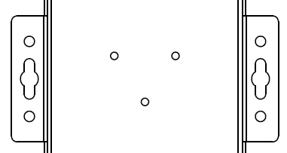
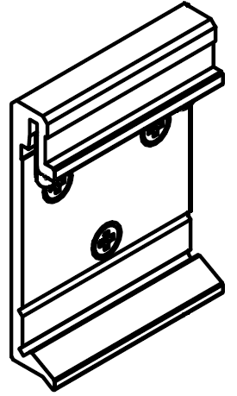
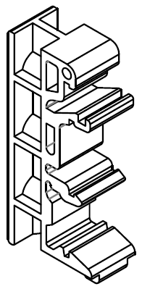
MOQ | 2pcs
MPQ | 2pcs/box
Model Name | Description
DS105 | Industrial 5-port Unmanaged Ethernet Switch
 | Package List
 | 1 x Product Unit
 | 1 x Attached 3-pin Removable Terminal Block Connector
 | 1 x Quick Installation Guide
Item
CBL-MUSBA-MMICB-0.6M | USB A Type to Micro USB B Type Cable, 0.6M
CBL-MUSBA-MMICB-1M | USB A Type to Micro USB B Type Cable, 1M
DK-D1-1 | DIN Rail Kit with 1 Aluminum DIN and 3 screws
DK-D2-2 | DIN Rail Kit with 2 Plastic DIN and 4 screws
DK-D1-1
DK-D2-2

Slide 5
Revision History
Version | Description | Date | Editor
V1.00 | Initial release | Aug.14,2018 | Andrew
V1.01 | Update power by E-Test Add product photo | Oct, 2, 2018 | Andrew
V1.02 | Add redundant power | Oct, 16, 2018 | Andrew
V1.03 | Add optional accessory: USB cable | Nov, 27, 2018 | Andrew
V1.04 | Add optional accessory: DIN kit | Nov. 29, 2018 | Kylie
V1.05 | Update ordering info within MOQ/MPQ. | Dec. 5, 2018 | Kylie

