Slide 1

WoMaster
WR322-EC and LR140
Quick start & OTA integration
Brian

Slide 2
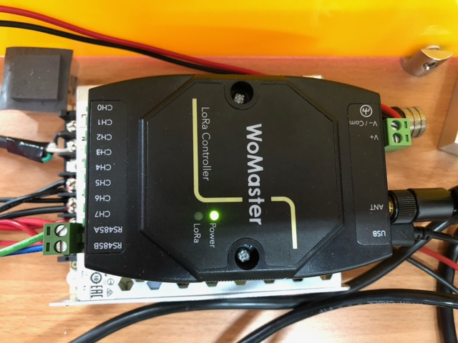
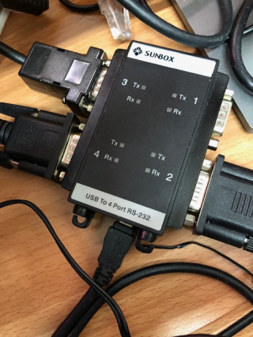
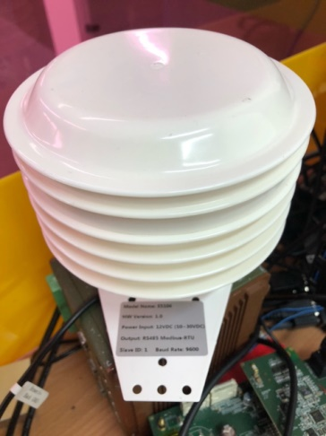
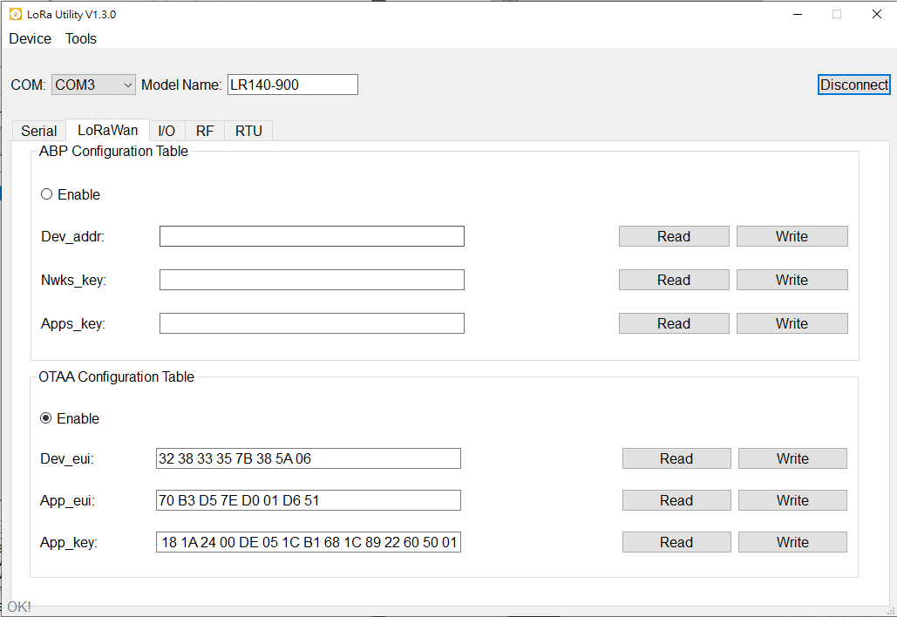
RS232 and RS485 connection on LR140
RS485A
RS485B
USB-To-RS232
ES104
LoRa Windows Utility

Slide 3
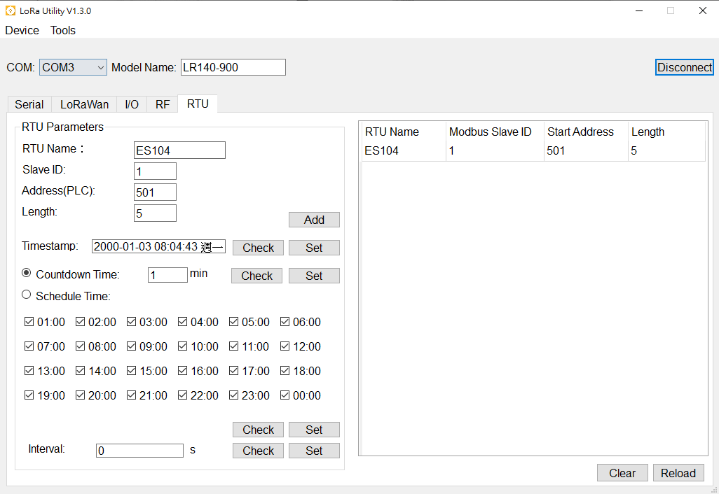
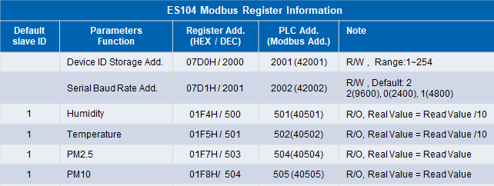
RTU settings on LR140
RTU -> RTU Parameters -> Enter Sensor Slave ID, Address
, Length -> Add
Example: ES104, Slave ID :1, Address(PLC):501
, Length: 5
Select Countdown Time -> 1 minutes -> set
(set LR140 every 1 minute to send RTU data to
LoRaWAN)

Slide 4
LoRaWAN settings on LR140
Get LoRaWAN node deveui and appkey for OTAA join
Select OTAA Enable
Join to LoRaWAN Server by OTAA (over th air)
Disconnect USB and repowering, the LR140 will auto join
LoRaWAN gateway and auto send LoRaWAN packet in a period

Slide 5
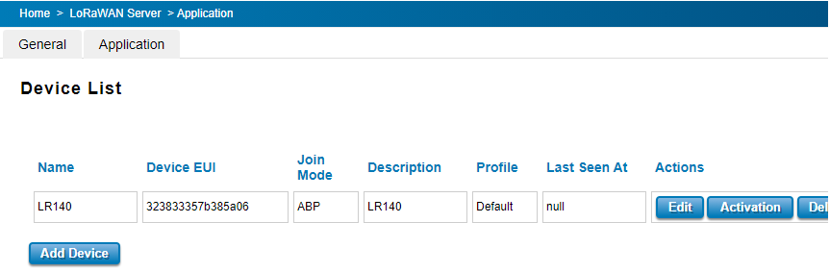
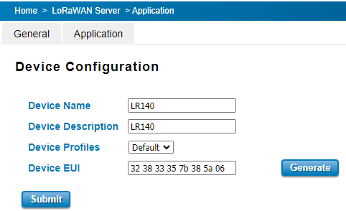
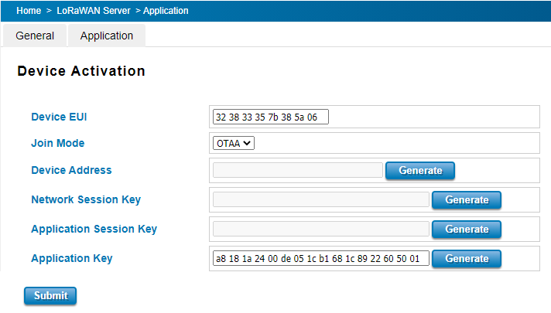
Add LR140 Device Info to WR322-EC
http://host:8088/index.asp
LoRaWAN Server-> Application-> Devices -> add Device
Paste the DevEUI -> Submit
LoRaWAN Server-> Application-> Devices -> Activation, Select Join mode to OTAA, paste Application key -> Submit

Slide 6
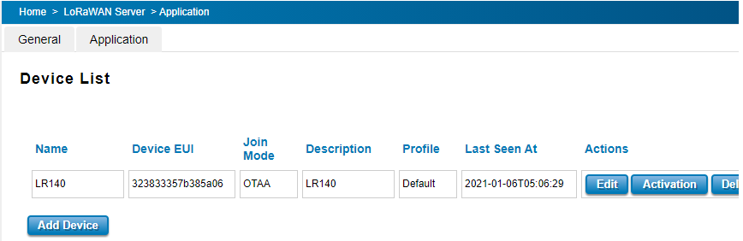
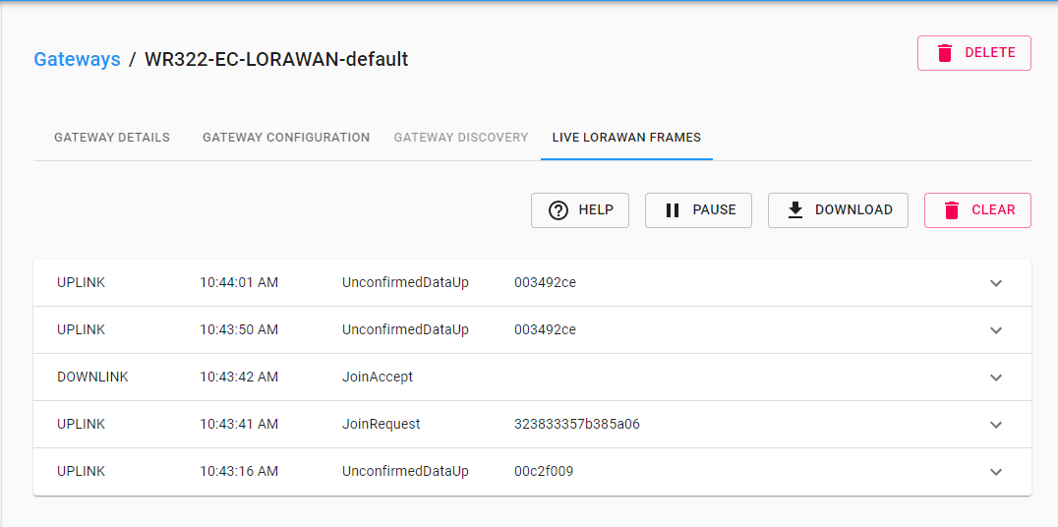
Display LR140 data on WR322-EC
Connect to http://host:8088/index.asp -> Application/Device List/Last seen at
Connect to http://host:8080 (username/passwd: admin/admin)-> Gateway -> WR322-EC -> Live LoRaWAN Frames. You can see WR322-EC received data through LoraWan

Slide 7
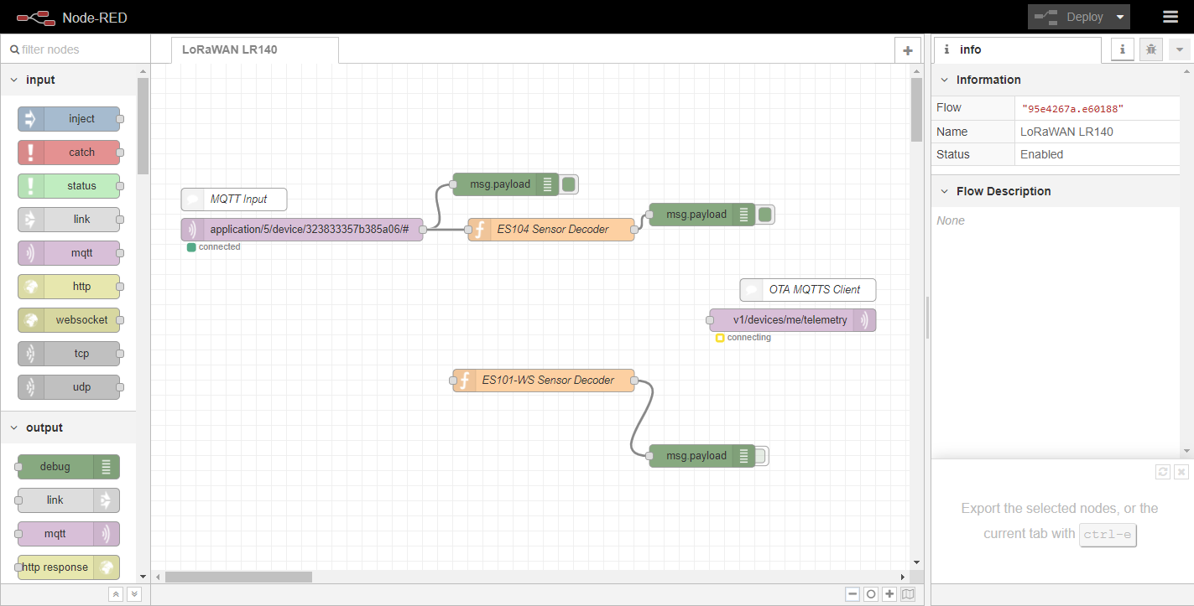
Open Node-RED on WR322-EC
Open the node-red on your browser: http://<EC Series IP Address>:1880
For example: http://192.168.1.1:1880
And you will directly see the default flow for LoRaWAN LR140 and ES104/ES101-WS sensor

Slide 8
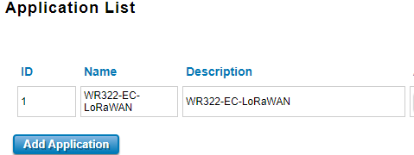
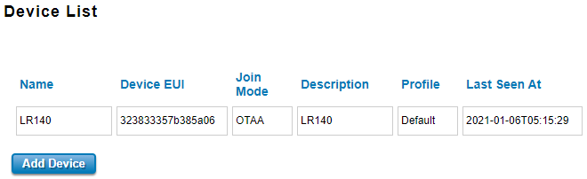
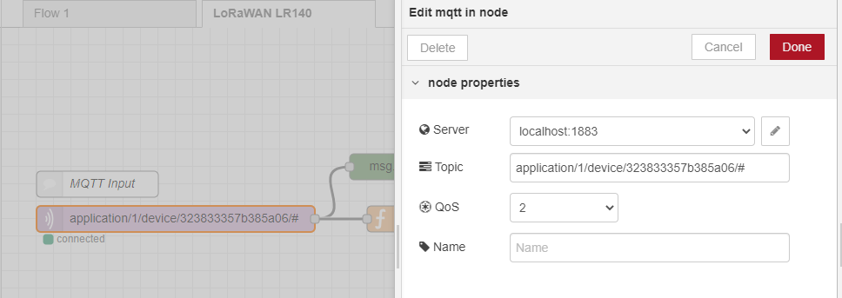
Edit MQTT input for LoRaWAN server
Edit mqtt node
Edit Topic “application/[ApplicationID]/device/[DevEUI]/#” to get device data
Example: application/1/device/323833357b385a06/#
Click “Deploy”to apply settings

Slide 9
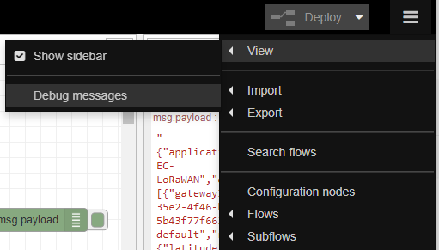
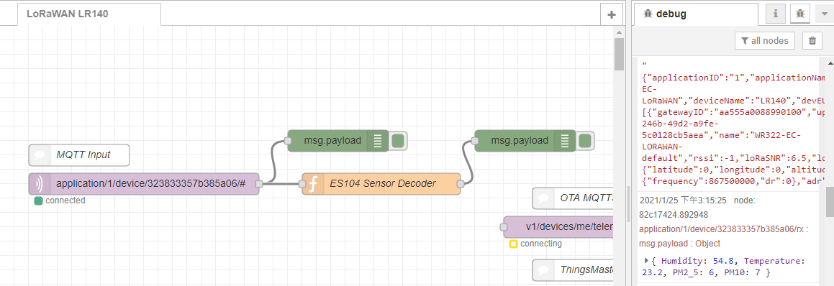
Display Sensor ES104 data by Node-RED
View -> Debug Message
It will display LR140 mqtt data and ES104 decoded data
The ES104 decoded data will be {"Humidity":58.8,"Temperature":21,"PM2_5":4,"PM10":4}

Slide 10
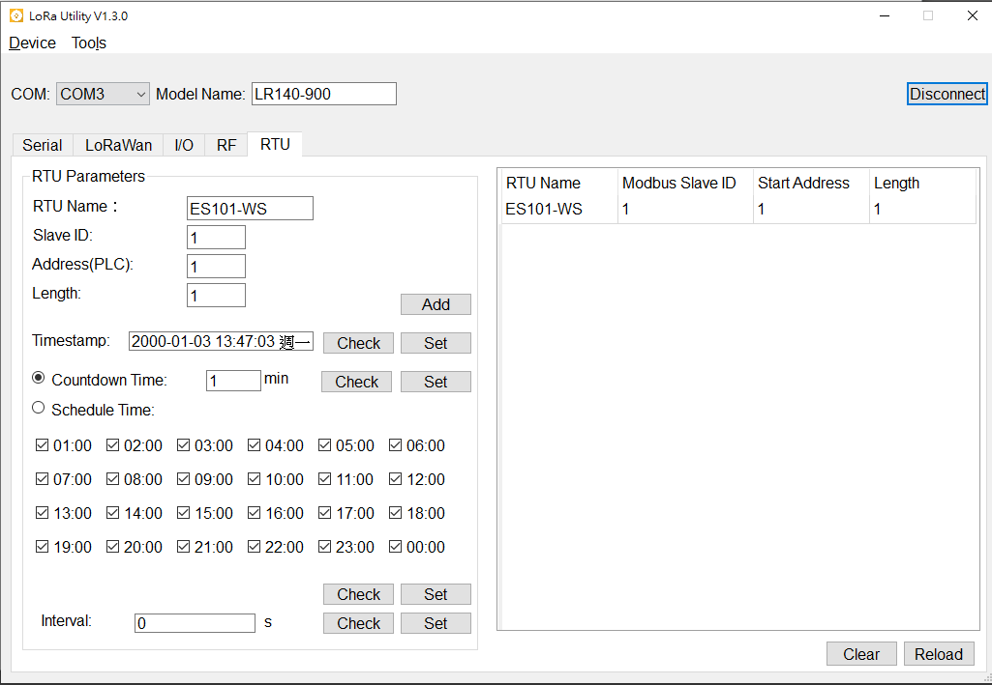
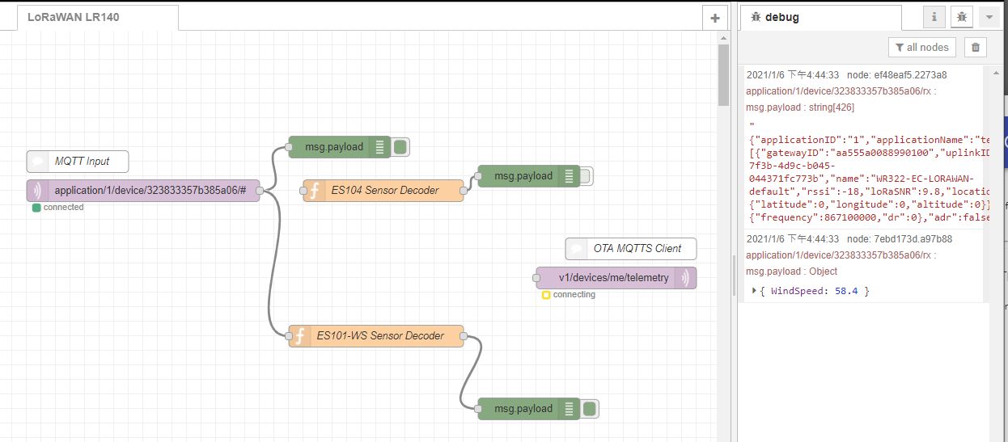
Display Sensor ES101-WS data by Node-RED
Replace Sensor ES140 to ES101-WS
Disconnect MQTT Input and ES104 node
Connect MQTT Input and ES101-WS node
The ES101-WS decoded data will be {"WindSpeed":58.4}

Slide 11
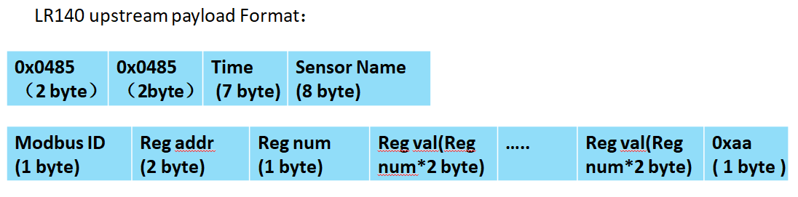
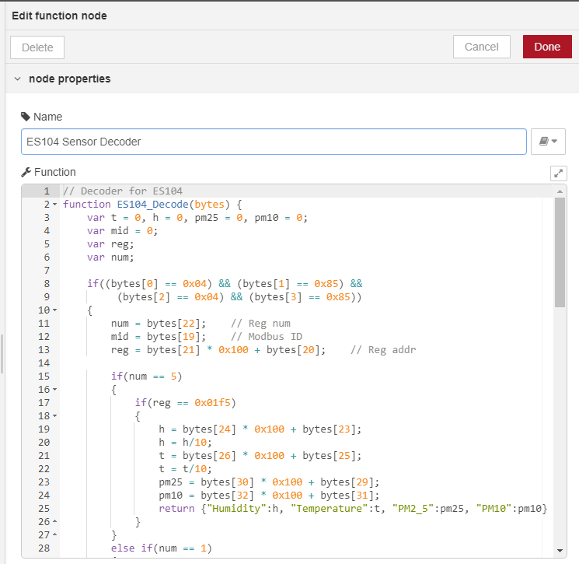
LR140 payload format and decoder
You will see LR140 data encode by base64
Example:
“BIUEhRQMHgMHMgBFUzEwNAAAAAH1AQUeAtIAswEFAAYAqg==”
Convert base64 to Hex:
04850485 140c1e 03 073200 4553313034000000 01 f501 05 1e02
d200 b301 0500 0600 aa
Sensor Name: “4553313034000000” -> “ES104”
Modbus ID: 01
Reg addr: “f501” -> 0x01f5 = 501
Reg num: 05
Reg 1 value: “1e02” -> 0x021e = 542 -> Humidity: 54.2
Reg 2 value: “d200” -> 0x00d2 = 210 -> Temperature: 21.0
Reg 4 value: “0500” -> 0x0005 = 5 -> PM2.5: 5
Reg 5 value: “0600” -> 0x0006 = 6 -> PM10: 6
You can add decoder for other sensors by copy the
“ES104 Sensor Decoder” and modify it.

